Slide 1
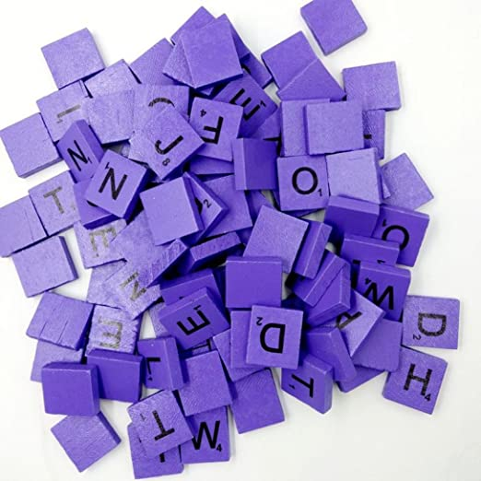
Guess The Word

Slide 2


Who are we?
Vasil Stanchev
Martin Atanasov
Krasiyana Kamburova
Emil Ribarev

Slide 3



Semantic skills
Phonological skills
Vocabulary improvement
Understanding of vocabulary
Easier for children

Slide 4
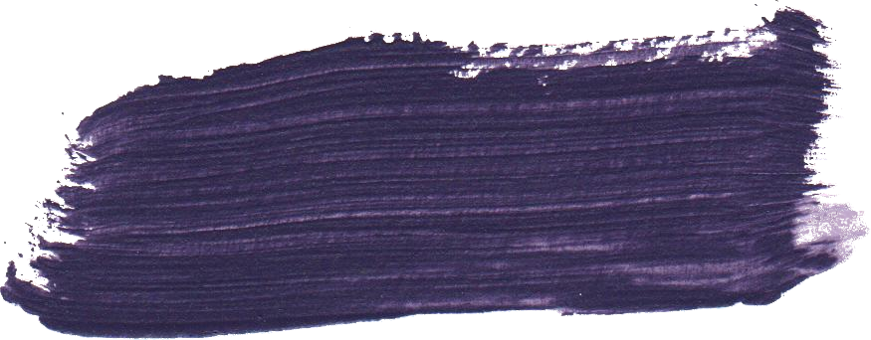

Main steps
Defining the main idea
Defining the purpose of the project
Implementing the project by writing code

Slide 5
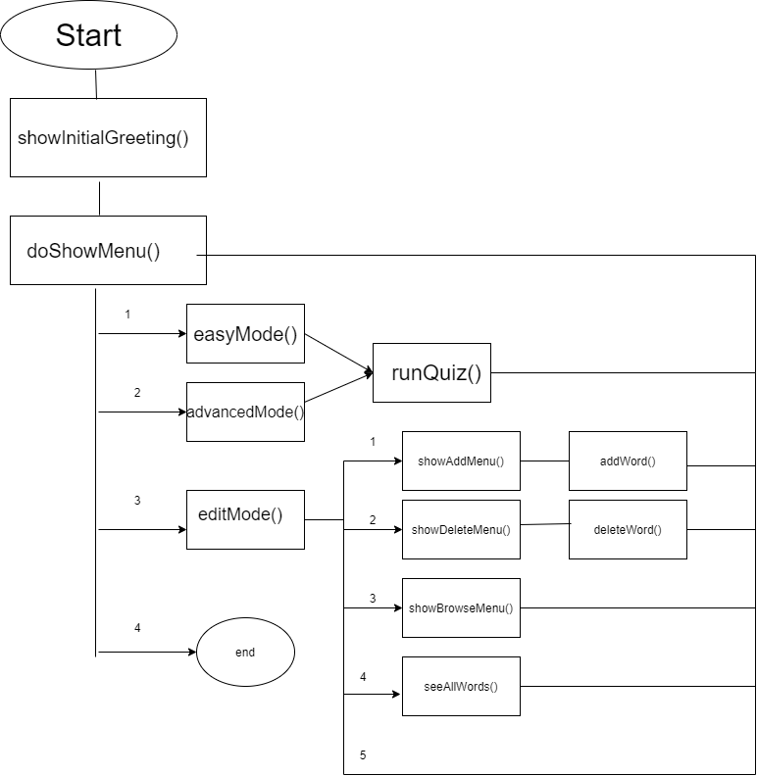
Diagram of our program

Slide 6




Technologies used

Slide 7


